Slide 1
A whole school approach
Podd in practice
Sarah Rusbridge
Richard Cloudesley School
Notes:
Thank you to Gillian
Introduce myself
-have been based at Richard Cloudesley for about 2 years
-PODD was embedded when I arrived
-Dan Cooper involved from the beginning of that process back in 2011
-Glad to have him here today to answer any questions!

Slide 2
Aims of presentation:
To provide a brief overview of PODD
To share case histories from Richard Cloudesley School
To demonstrate measurement of outcomes
To signpost to further resources
Notes:
4 aims

Slide 3
What is PODD?
Pragmatic Organisation Dynamic Display
Notes:
Don't want to teach grandmother to suck eggs
Show of hands please:
-who here is using PODD?
(Tell group the numbers)
In what settings?
Show of hands for:
-special schools?
-Preschool?
-Mainstream school?
-Other?

Slide 4
Key features
Pragmatic
Efficient
Eg. Operational commands
Dynamic Display
Range of page sets
Different formats with comparable features
Range of access methods
Eg, eye gaze, partner assisted scan, coded access
Lists
Notes:
(6 features)
1. Pragmatic:
Vocabulary organised according to communication function and conversational discourse requirements: predictably associated vocabulary (demonstrate on slide 8)
What does child need to say, when, to whom and how?
Eg Pragmatic branch starters ( - use slide 6 to demonstrate)
2. Efficient
3. DYNAMIC: Symbols change based on previous selections
4.PAGE SETS: one page, two page, two with side panel, symbols per page
5.Access methods, eg:
-Direct
-Partner assisted scanning
-Pick up and show
-Eye gaze
-Coded access

Slide 5
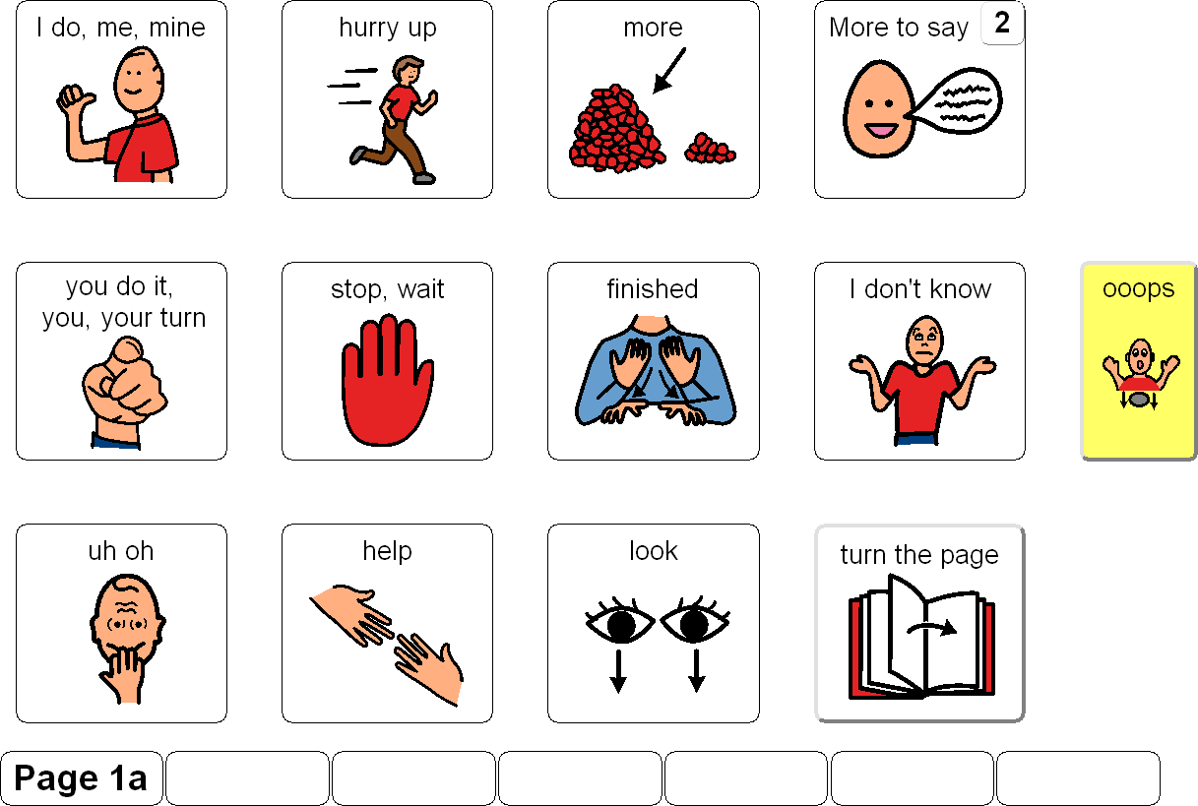
Notes:
Here's an example of how it works with a 12 symbols per page book
More to say

Slide 6
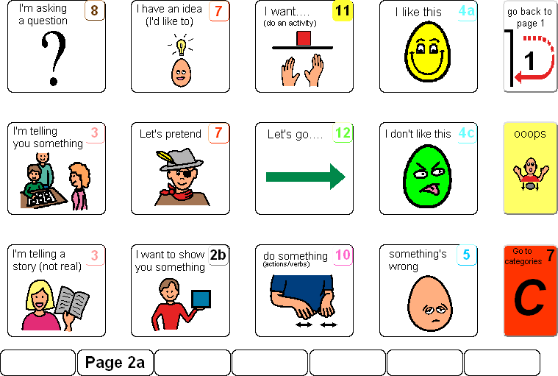
Notes:
Pragmatic branch starters – explain.
Point out operational commands in control panel.
Something's wrong.

Slide 7
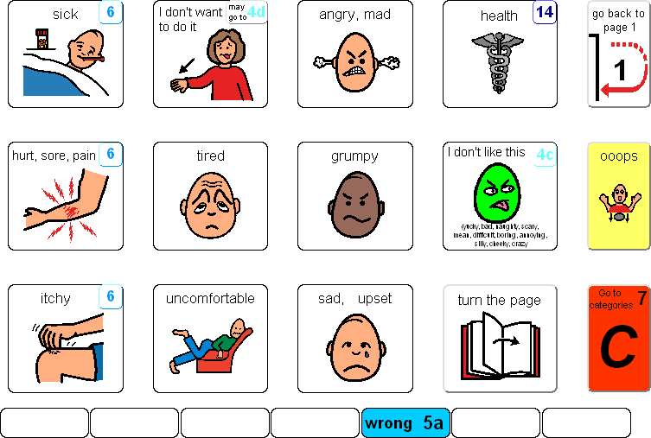
Notes:
Hurt, sore, pain

Slide 8
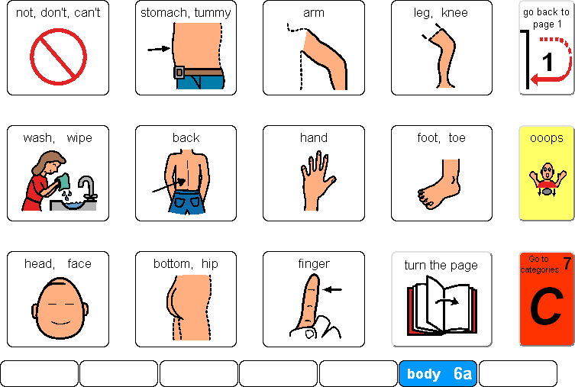
Notes:
Select message
Show predictably associated vocab

Slide 9
A brief history of PODD at Richard Cloudesley
2011 – new starter arrived in early years with a PODD book
2012 SLT and Head of Primary attended 5 day training course
A whole school development plan was drawn up to ensure PODD could be rolled out throughout the school
School Improvement Plan
Training needs
Resources identified
Student need identified
Family involvement
Challenges and Rewards
Sustainability
Notes:
0.Prior to PODD, Caroline described communication as happening during SLT sessions and during "communication" groups.
1.2.
After bullet 2:
Recognised need for a change of ethos
Communication had to belong to the whole school and to be available all the time in all settings
Expectations had to be changed – what did each child have the potential to do?
Challenges: logistical, ideological, professional
Rewards – whole team involvement in communication everywhere

Slide 10
Case Study A
Background Information:
8 year old boy
Perinatal HIE secondary to Birth Asphyxia
Cerebral Palsy
Global developmental delay
Epilepsy
Dual sensory impairment – CVI and HI
Notes:
Hypoxia ischaemic encephalopathy
Cortical visual impairment
Hearing impairment

Slide 11
Transitioned to RCS aged 6 1/2 years
Had an A5 communication book with 4 symbols per page from previous school
Communication partners using auditory scanning
Able to nod head for yes and shake head for no

Slide 12
Which book?
Notes:
All those involved – parents SLTs, Teacher, QTVI,

Slide 13
Dynamic Assessment
What facilitates function and success?
What inhibits function and success?
What other strategies need to be explored?
What is their potential for learning?
Assessment
Current observation
Intervention
Notes:
Initial assessment period using a 9 per page partner assisted scanning book (normal PCS symbols)
AUDITORY PLUS VISUAL SCANNING
MDT approach looking at:
Attention
Receptive language
Use of expressive skills
Interaction and social skills
Problem solving
Motor skills
Vision
Hearing
Sensory processing
Class Teacher
QTVI
Independent SLT
PT/OT
Pragmatic Profile completed by Mum

Slide 14
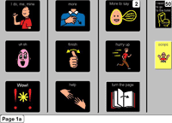
Notes:
Visual regard – decided to go for symbols, not solely auditory
Considered different contrast options
Chose current format so not having to relearn symbols in grid 2
We went for a 9 per page expanded function which met functional communication requirements and language development requirements
(Class teacher proposed 12 per page because good level of understanding)

Slide 15
Implementing & Progressing
Class based sessions
Explicit teaching
Ongoing modelling+++
Practice copy provided for parents
PODD training to parents
Notes:
1.Ensuring consistent method of modelling
Instructions in book
VR code with instructional video
2. EgTeaching no response means no to minimise communication effort
After point 5:
Book was provided towards end of first term
Unfortunately spent most of Spring and Summer terms in hospital
Returned towards end of summer term
Demonstrating expressive use of book

Slide 16
One year on…
Familiar with vocabulary
Combining symbols
Yes and No responses clearer
Not initiating
Notes:
(Not now, but Autumn 2015)
4 points

Slide 17
Next steps…
Has just received 20 symbols per page A4 book
Learning to increase auditory scan to 4 cells
Familiarising himself with new vocabulary
Dynamic assessment continues
Pragmatic Profile to be reviewed
Accessing PODD grid with Eye Gaze Technology
Notes:
1. Why 20 symbols?
Lists from last book indicated level of vocabulary required for functional communication and language development
16 and 20 both require vertical scan of 4 symbols
3. 20 per page has more predictably associated vocab therefore facilitates combining words
4.Dynamic assessment
Eg - vision? Should not reduce the number of symbols per page based on access method – is he managing current vocab with current access

Slide 18
Notes:
Video
I was trying to film, and use PODD at same time so couldn't see properly. TA therefore helped me.
Whole school approach – TA assists SLT ;-)

Slide 19
Case study B
Seven year old girl
Born 24/40
Global Developmental Delay
Diagnosed with Cerebral Palsy aged 21/2 years
Concerns from age 3 around social communication
PECS Symbols introduced soon after
Started at RCS nursery aged 4
Notes:
2. Stormy neonatal period as might expect
3.Known to Early Years MDT
5. Age 3 – rigid behaviours, limited eye contact, little interest in peers at playgroup,not pointing
6.PECS symbols initially not looked at, mouthed and thrown
7. Started at RCS where language of classroom was English supported by PCS symbols in PODD books (class books). Only PECS user in the class.
Introduced photos and symbols for choice making, now and next boards.
And Aided Language Stimulation boards

Slide 20
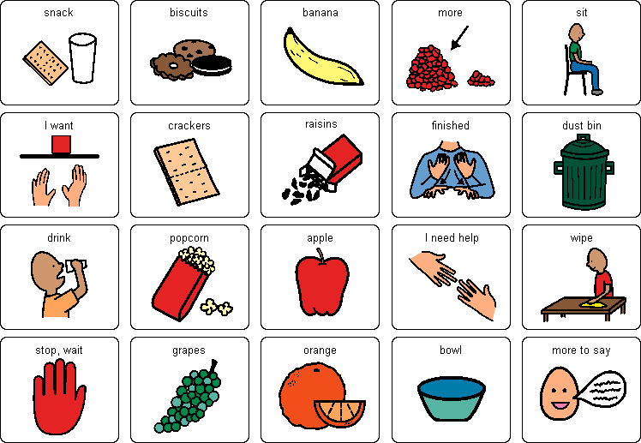
Notes:
Aided Language Stimulation boards
Topic and activity displays
And/or
Activity pages from PODD eg bubbles / snack
Provide vocab to make choices
Includes some core vocabulary and predictably associated vocabulary
Limitations
No autonomy
Not with child all the time
Limited to request function
Symbols may not be routinely placed

Slide 21
How to transition from PECS to PODD?
Pick up and show
Notes:
Wanted to move OJ into a static system (preferably PODD) with opportunity for wider communicative function but first she needs to learn:
Purpose of formally involving another person
Alice developed a PODD board for morning circle time containing a removeable symbol.

Slide 22
Case Study B continued
Diagnosed with Autism aged 5
Notes:
1. By this time she had achieved PECS stage 1 and 2
She had also had ongoing modelling of PODD
Not long after her diagnosis, OJ began pointing to certain symbols in the class PODD book.
Detachable symbols were now seen as a potential distraction and so she was given a 9 symbols per page expanded functions assessment book
Parent training

Slide 23
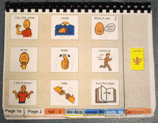
Notes:
She made good progress in using direct access to point to single words
She would sometimes try and take the adult communication partner's hand to direct them to point – this needed to be discouraged
Within a few months she was moved to a 12 symbols per page book and adapted well to a new format.
This book had an opportunity to ask for sensory help
Headphones
Weighted vest
Squeeze

Slide 24
Aged 5 1/2 transitioned to an A5 Book with 20 symbols per page
Sensory help was placed on front page to minimise page turns
Pragmatic profile recorded
Aged 6 received PODD on the Compass app for iPad
Notes:
1.2. You will be able to see these in video

Slide 25
Now…
Aged 7
Continues with 20 per page book
And PODD 15 on Compass app
Prefers using book in school
And Compass app at home
Pragmatic Profile due to be reviewed

Slide 26
Notes:
INSERT VIDEO
Spot the deliberate mistakes.
Any comments after the videos?

Slide 27
Measuring outcomes
Lots of anecdotal evidence
Need to ensure we measure impact on individual children
Justify future investment
Notes:
1.
2. Need to measure individuals to inform our clinical decision making
Challenge of measuring outcomes from a naturalistic intervention
3. Published clinical research would encourage and support wider use
Anyone interested in research project?

Slide 28
The Pragmatics Profile of Everyday Communication Skills in School-Age Children
Dewart & Summers, 1995
Communicative Function
Response to Communication
Interaction and Conversation
Contextual variation
Notes:
1. This measures 4 aspects of communication:
2-5.
Whole school approach – liaison with teachers, parents and other professionals in completing these.
Try to do this before child gets a PODD book, then review at one year.

Slide 29
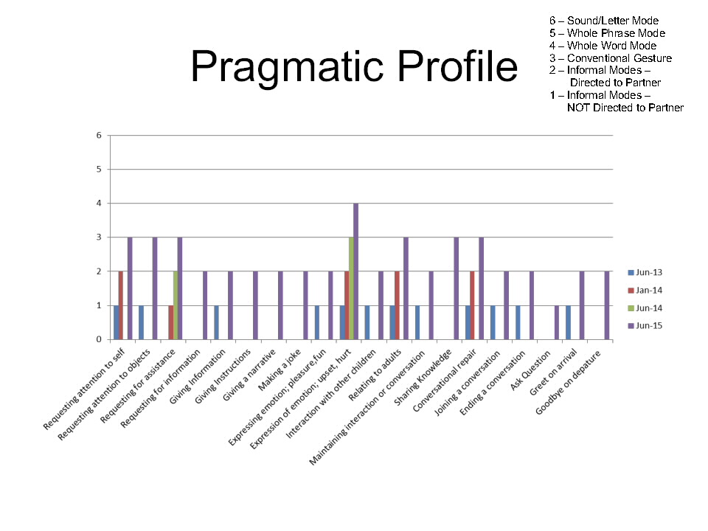

Slide 30
Further links and resources
For PODD training courses:
podd@woodlands.surrey.sch.uk
Training@acecentre.org.uk
PODD Network Meetings:
Facebook Groups:
PODD Europe
PODD and Alternative Access
Notes:
Woodlands: one day course in May
Two day training June 20/21

Slide 31
Thank you – any comments or questions?
Notes:
Show books if anyone wants to see them

