Slide 1
AAC SIG 13/11/2015
MyGaze and
The Inclusive Learning Curve Software
Jamie Munro – Information Director

Slide 2
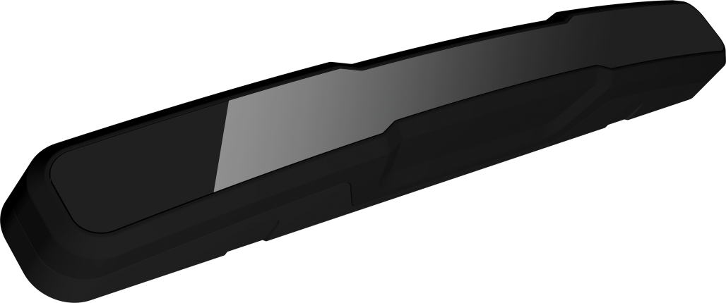
MyGaze
Works with any software and is easily accessible to everyone.
Light, small & portable: Simply snap the myGaze® Eye Tracker on to your PC, laptop and tablet.
Superior performance and reliability: a product of 20 years of R + D.
Easy and calibration-free setup and large head box assure a comfortable experience.
Use across all your Windows devices with 10”- 22” screens.

Slide 3
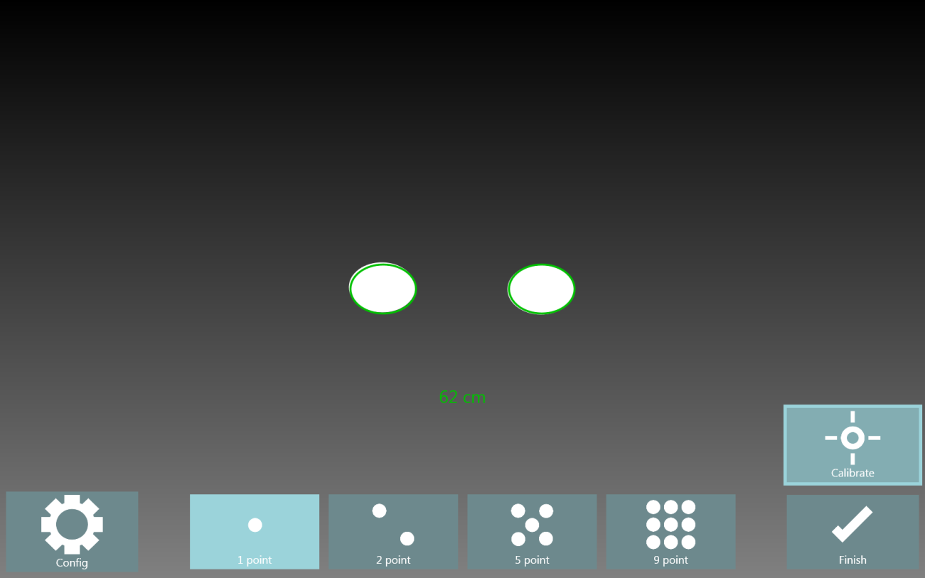
EyeMouse Play
1. Position - use the intuitive “glasses” guide to quickly gain optimum positioning for eye gaze.

Slide 4
2. Calibrate - an easy one point calibration gives great functional accuracy. Option to change colours and stimulus

Slide 5
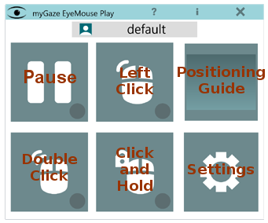
3. Go - Simply choose the cursor function and dwell settings you want and you are ready to eye gaze!

Slide 6
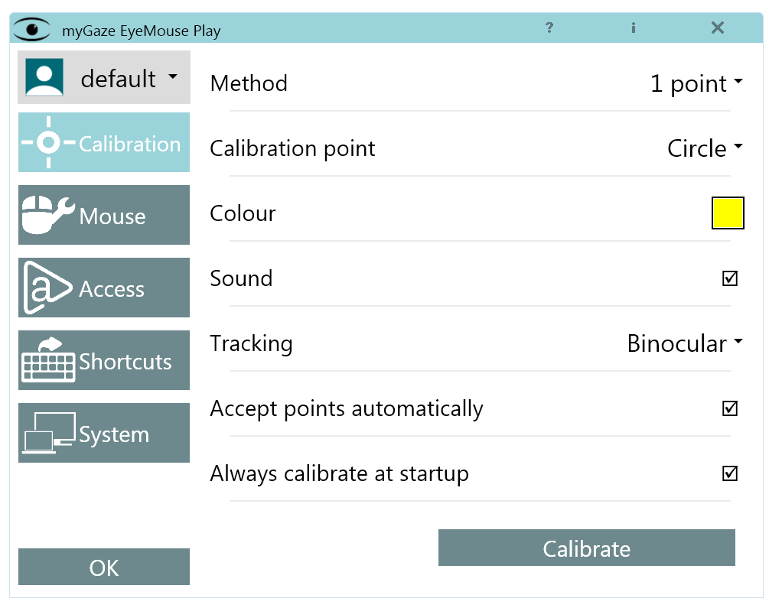
With more advanced features if you need them …

Slide 7
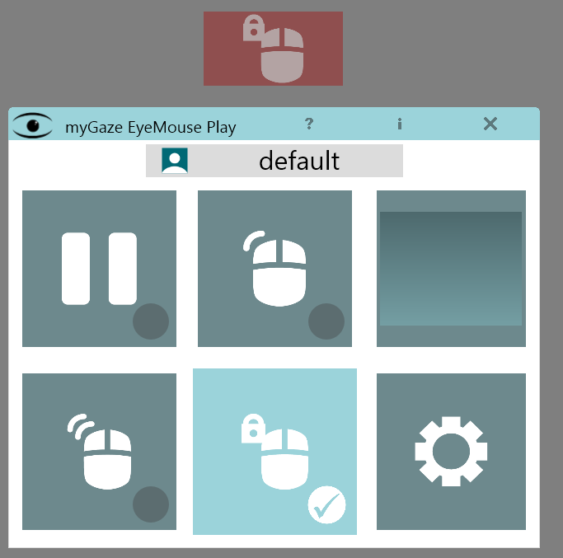
Optional on screen Access Button gives users the option of selecting the click functions for more independence

Slide 8
Inclusive Eye Gaze Learning Curve
Access
Mouse over Single Click Targeting Click and Drag Scrolling More Mouse + Keyboard
Learning
Sensory Tracking Exploration Turn Taking Choosing Communication

Slide 9
Attention and Looking
Attention and Looking - 18 carefully graded activities for use with eye gaze devices and designed to assess and teach:
attention and looking skills
simple access skills
understanding of eye control

Slide 10
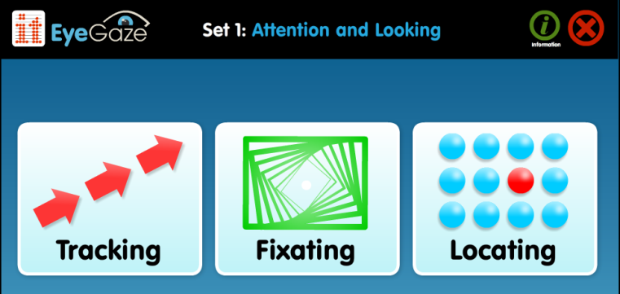
Tracking What are you looking at?
Activities designed to attract attention and encourage learners to look at and follow images on screen.
Assessment of eye movement patterns, visual attention, preferences and discrimination skills.
Graded teaching of tracking and scanning skills

Slide 11
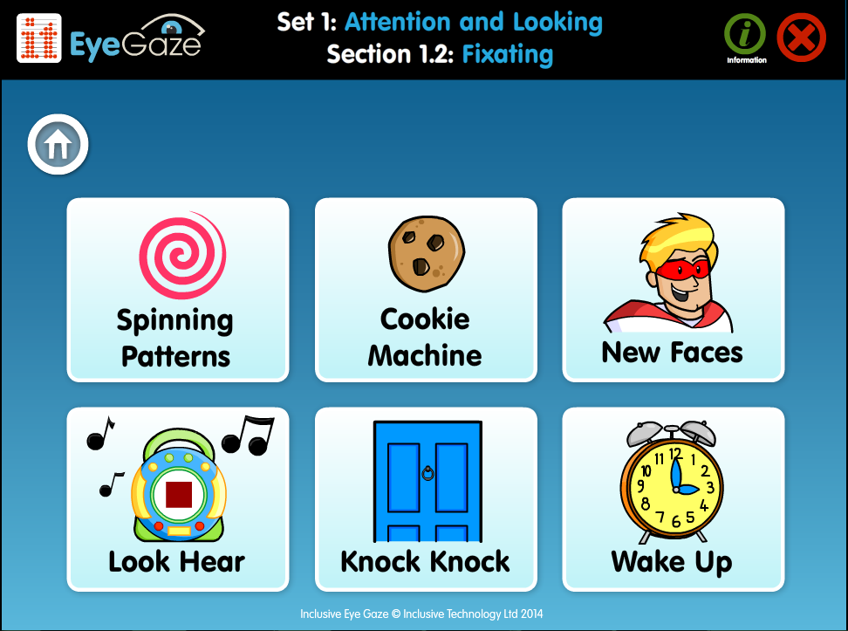
Fixating Are you looking?
Motivating activities designed to encourage learners to look and keep looking at the screen.
Assessment of visual attention and fixation skills.
Graded teaching of dwell select skills for single targets.

Slide 12
Locating Looking around
Fun and meaningful activities that provide immediate success and feedback.
Assessment of visual scanning skills and learners ability to use their eyes to explore the screen.
Graded teaching of using cursor movement in a purposeful way.

Slide 13
Options
Extensive option menus allow you to:
Personalise for assessment and teaching goals
Provide progressive teaching steps.
Ensure success and motivation

Slide 14
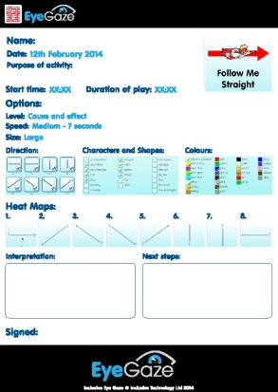
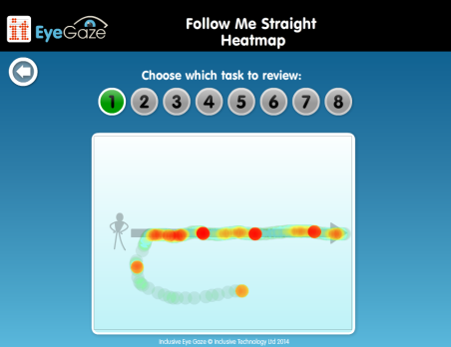
Analysis
Powerful, easy to use Analysis tools allow you to record and review eye gaze skills with:
Live video playback of eye gaze behaviour during activities
Heat map recording showing areas of concentrated gaze during activities
Line trace map recording showing path of eye gaze during activities
Instant report and record keeping with ability to save recordings

Slide 15
Exploring and Playing

Slide 16
Include – Turn Taking
Take Turns
Introduce concept of choosing from more than 1 item on a screen. Includes sequential, forced order and two player access.
Develop dwell select skills of 2+ large targets.
Teach turn taking concepts;
take turns to interact,
take turns to do a job,
take turns to play a game

Slide 17
Eye Gaze – Exploring and Control
Explore
A progression of easy to access targeting activities.
Develop dwell select skills with 4 – 8+ targets and introduce select and drag access.
Teach purposeful exploration of the screen and early control skills.

Slide 18
Include – Choice Making
Choose Anything
Introduce choice making with multiple errorless choices.
Develop and reinforce multiple target access skills.
Teach early choice making skills and provide opportunities to express preferences in an error free environment.

Slide 19
Choosing and Learning

Slide 20
Include – Choice Making
Preferred Choices
Introducing a cognitive or decision making element to choosing with easy access targets. Preparation for simple quiz access e.g. ChooseIt! Maker 3.
Assessment of early concept understanding and decision making abilities.
Teaching decision making skills using early concepts

Slide 21
Include – Choice Making
Liner Choices
Introducing multiple choices presented one at a time for easy decision making. Preparation for simple book access.
Assessment of choice making skills.
Teaching ‘scrolling’ through choices and simple decision making.

Slide 22
Include – Choice Making
Multiple Choices
All activities have a cognitive or decision making element to choosing with multiple targets. Including dwell click and click and drag access. Preparation for word or symbol grids access.
Assessment of choice making skills with multiple choices.

Slide 23
Inclusive Technology
Riverside Court
Huddersfield Road
Delph
Oldham OL3 5FZ
Tel: 01457 819790

