Slide 1
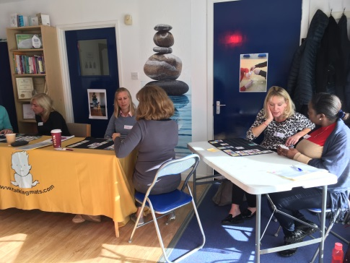
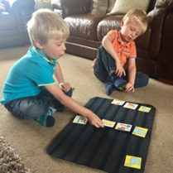
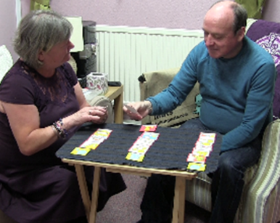
What’s new in Talking Mats?
Dr Joan Murphy
AAC Study Day Oxford
June 2019

Slide 2
Overview
10.00 -Start and Introduction
Background to Talking Mats
Research – recent and current
Resources – what's new and what we're planning
Digital Talking Mats
Training – current and new ways of training
12.30 – 1.15 Lunch
Projects – some of the innovative ways Talking Mats is being used
Helen Paterson’s research
Specialist discussions (suggestions provided at start of day)
Future ideas
3.30 Finish

Slide 3
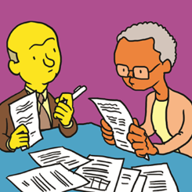
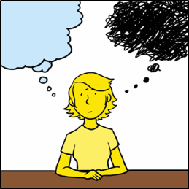
Discussion themes
Thinking Ahead
Supporting people to plan for the future
Eating and Drinking
Decision making journey
Keeping Safe
Views around difficult and sensitive issues
Capacity
Supported decision making

Slide 4
Background
Speech and Language Therapist (AAC)
Researcher at University of Stirling
Director and Consultant with Talking Mats

Slide 5
Talking Mats vision
To improve the lives of people with communication difficulties by increasing their capacity to communicate effectively about things that matter to them.

Slide 6
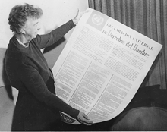
Universal Declaration of Human Rights Act 1948
People have the right to express opinions and communicate information and ideas in different ways’ Article 19 UDHR
Communication is:
the medium through which people claim or assert their rights
central to how we enjoy other human rights: to vote, to education, the right to participate in community life, the right to work
‘To deny people their human rights is to challenge their very humanity’ Nelson Mandela

Slide 7
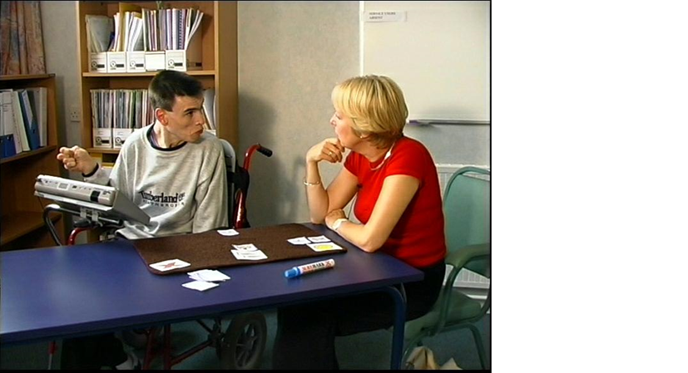
What do we mean by communication?
Main purposes - Janice Light (1988)
Needs and wants
Information transfer
Social closeness
Social etiquette
The construction and enjoyment of relationships with others (Light)
Small talk - John Locke (1998)
Not a mathematical formula of phonemes, morphemes and syntax, but rather includes casual conversation such as gossip (Locke)

Slide 8
Why pictures?
“A picture paints a thousand words…”
Meaning and connections
The brain processes images faster than words (60,000 x faster!)
Thinking is hard work…
Giving feedback and opinion is even harder
Rachel Woolcomb

Slide 9
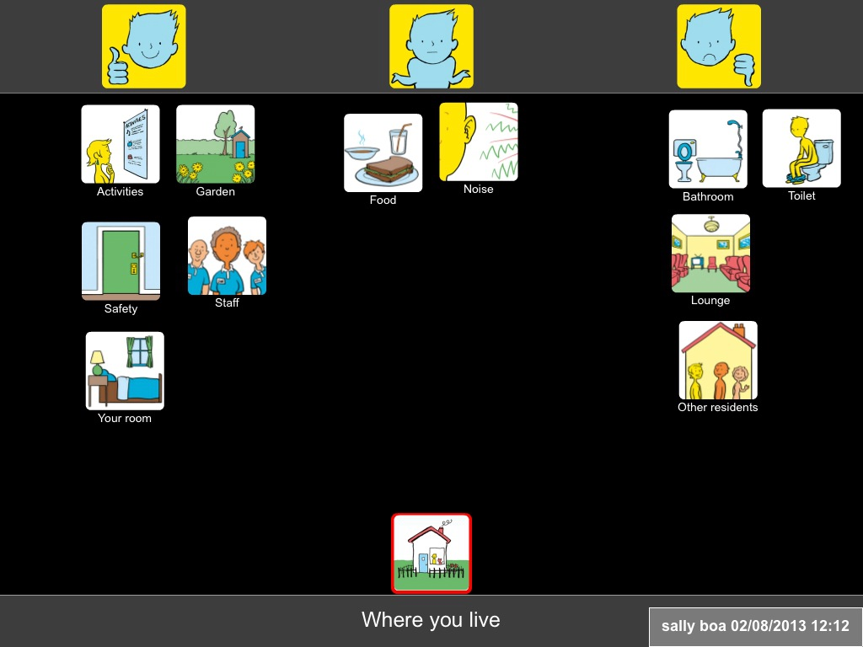
‘The apparent simplicity belies the complex interplay of actions that are required to produce an effective TM’ Elizabeth Clark - University of Canberra
Top Scale
Options
Topic

Slide 10
Using Talking Mats
Health workers
Education workers
Social Care workers
Family members
Carers
Voluntary agencies
Advocacy workers
Police
Lawyers
Careers advisors
People with:
Learning Disabilities
Cerebral Palsy
Aphasia
Dementia
MND
Autism Spectrum
Additional support needs
Aged care
Encouraging interaction
Planning activities
Developing relationships
Goal setting
Self management
Determine outcome measures
Plan communication passport
Service Evaluation

Slide 11
Why does Talking Mats work?
Multi-modal
Provides structured framework
Breaks concept into chunks
Gives ‘thinker’ more time
Slows ‘listener’ down
Gives control to ‘thinker’
Non judgemental
Helps understanding, attention, weighing-up and expression

Slide 12
James and Maureen
https://youtu.be/BuyoTzEz0yQ

Slide 13
The Evidence Base
Initial research at University of Stirling with people with a variety of conditions; cerebral palsy, MND, stroke, learning disability, dementia, children with additional support needs
Talking Mats is now used in research world-wide (e.g. Sweden, S Africa, Denmark and Australia)
Key research finding: Talking Mats helps people to say more and the quality of what they say is improved
www.talkingmats.com/projects/
Notes:
Talking Mats came about from a research project conducted by Joan Murphy in 1998 with people with cerebral palsy who were using hi-tech communication aids. The research looked at the peer interactions between people who use communication aids in a residential unit. When feeding back to users about the research and its findings, Joan found they didn’t have the vocabulary they needed in their systems, or the ability to express their views. She came up with the idea of a visual framework which allowed people to reflect, change their minds and express their views. From here Talking Mats developed.
Talking Mats has been researched with people with a variety of communication difficulties:
Quality of life projects
People following stroke
People with Motor Neurone Disease (Known as ALS in the States – Amyotrophic Lateral Sclerosis)
Life planning project
People with a learning disability
Well being
Older people and people with dementia
Children with emotional and behavioural difficulties
Research conducted at the Talking Mats Centre has included using mats to :
Find out individual views
Share views and perspectives on a topic.
If people want to get the research papers tell them to go to http://www.talkingmats.com/projects/
Effectiveness studies evidenced
Talking Mats both improves the quantity and quality of information when used with people with learning disability and dementia.
Who can and who can not use Talking Mats
All the research is listed on the web site and people should contact the centre if they wish to follow it up.

Slide 14
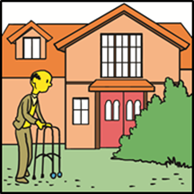
Completed Projects
Children with Exceptional Needs
Self-managing Long Term Conditions
Health and Housing
https://www.talkingmats.com/projects/research/

Slide 15
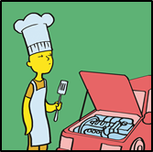
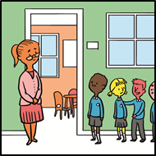
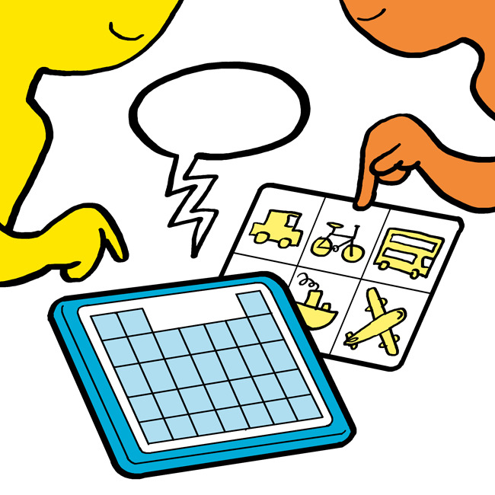
Current Projects
Employability
How was school today?
ACE Oldham

Slide 16
ACE Toolkit
Developing a Talking Mats AAC pathway
Will support practitioners to have conversations with AAC users around existing and potential AAC systems
New symbols being piloted
Will be available on the ACE toolkit and training would be available to organisations

Slide 17
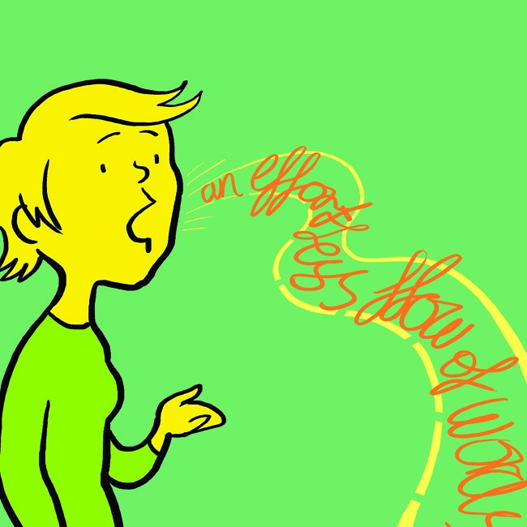
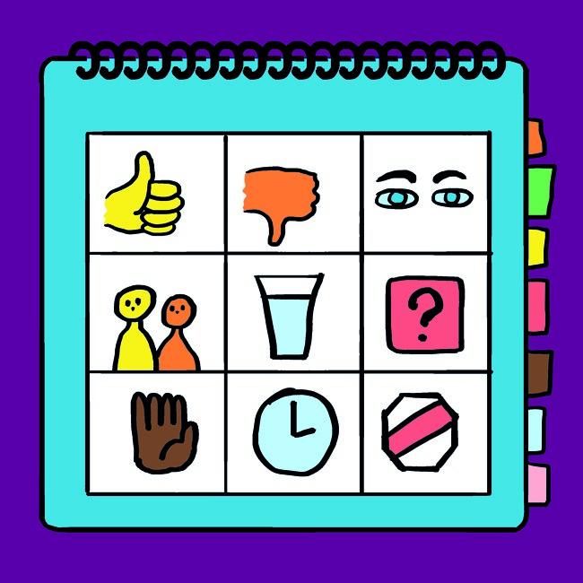
Modes of Communication
Verbal conversation | Paper conversation | Electronic conversation

Slide 18
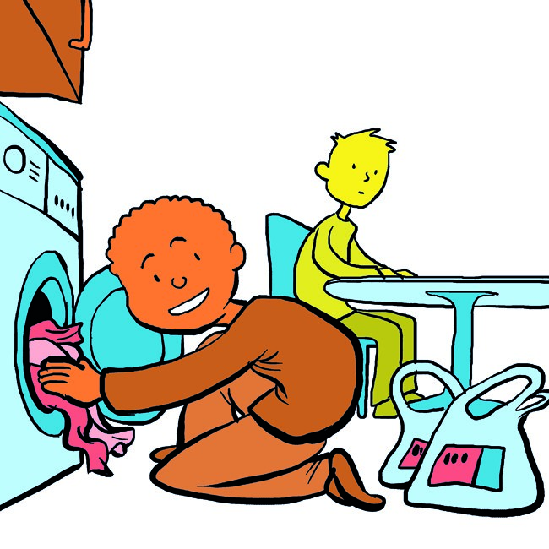
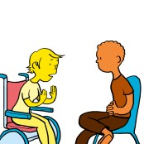
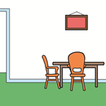
Topics
Types of conversations
Who?
Where?
Readiness for AAC

Slide 19
Resources
Health and Well-being #
Advanced Sets available post training
Eating and Drinking #
Consulting children and Young people #
Keeping Safe #
Social Care #
Thinking Ahead #
Conversation Sets
https://www.talkingmats.com/shop

Slide 20
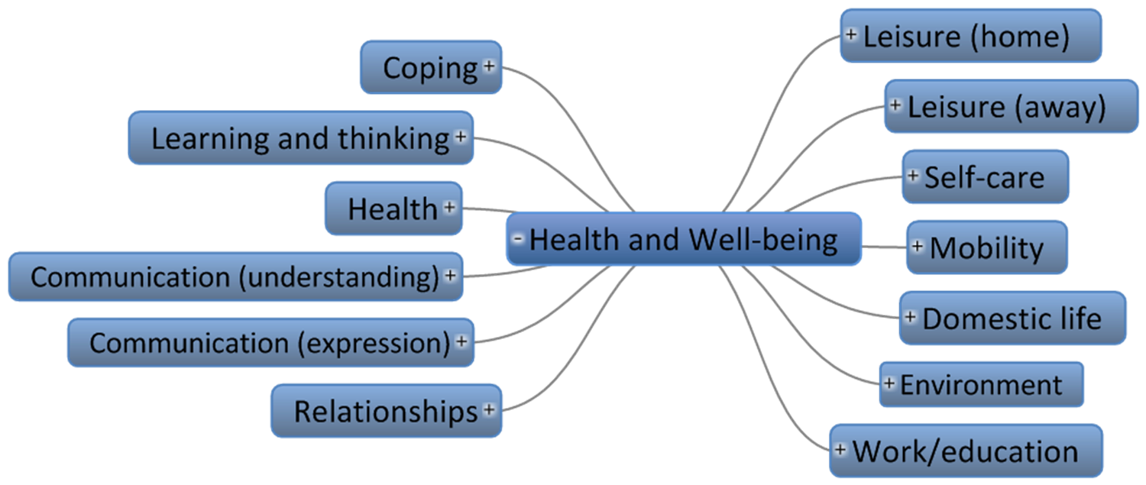
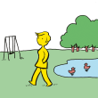
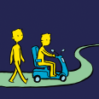
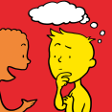
Health and Well-being

Slide 21
Conversation sets

Slide 22
Marlon

Slide 23
New features
Digital
Updated symbols
New symbols
German

Slide 24
Digital Talking Mats

Slide 25
Training
Foundation for Individuals
Foundation for Organisations
Online
Accredited
Specialist Seminars
Advanced modules online
https://www.talkingmats.com/training/

Slide 26
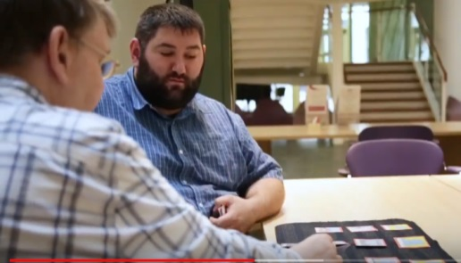
New training models
Family training
Parent training
Peer training
https://www.youtube.com/watch?v=1aer7v4fyFU&t=22s

Slide 27
Stewart and Grace

Slide 28
Lunch

Slide 29
Innovative ways of using Talking Mats
Scottish Learning Disability Observatory
To hold a citizen’s jury to explore the views of people with learning disability on health research
Easy read material to explain what research means
Then a Talking Mat to get a baseline of person's understanding of research concepts
https://www.sldo.ac.uk/projects/research-voices/

Slide 30
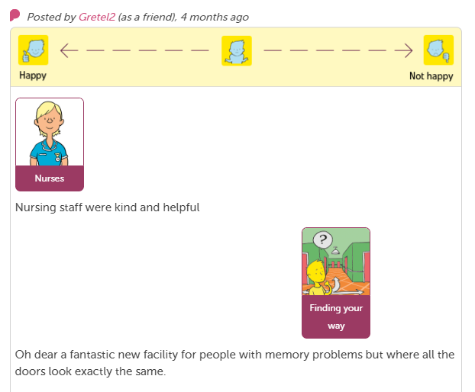
Care Opinion www.careopinion.org.uk
Care Opinion is an independent third sector organisation that supports feedback on health and care services.
Picture Supported Stories

Slide 31
Helen Paterson’s research
Using Talking Mats as a focus group tool with nurses

Slide 32
Others?
Using Talking Mats as a ‘Thinking Tool’ for Student Supervision Laura Holmes https://www.talkingmats.com/studentsupervision/
Scottish Referendum!!

Slide 33
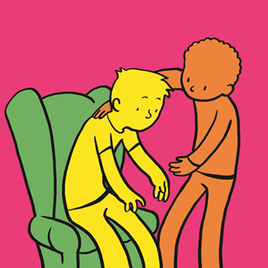
Thinking Ahead
Supporting people to plan for the future
Affairs Care/Treatment Personal values

Slide 34
Background
Having discussions about end of life plans can:
enable people to remain in control for longer
help them to identify the care and support they need
result in less invasive treatment
provide comfort and reassurance
Aline De Vleminck et al, 2013
Tasmin et al 2015
McCune, 2016

Slide 35
How we developed resource
Dr Sally Boa and staff at Strathcarron Hospice
Workshop identified topics and options
Affairs; Care; and Personal Values
Presented to staff from Highland Hospice for validation and checking
New symbols developed
Trialled with a range of people (with and without communication difficulties)

Slide 36
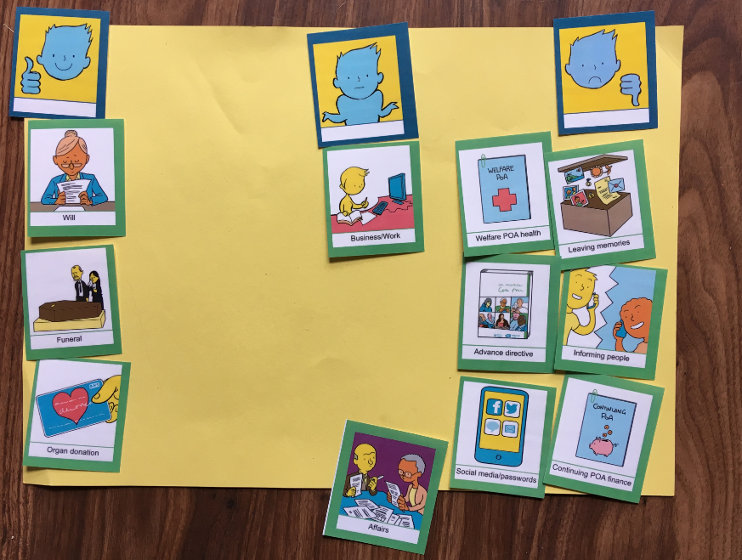
Thinking Ahead (Affairs) – Julia (sorted)

Slide 37
Talking Mats and Capacity

Slide 38
Judgements on capacity Taken from MCA (2005) and AwIA (2000)
Cannot be based on Age, Behaviour, Disability
Needs to be decision by decision – so not being able to make more complicated decisions does not apply to all decisions
Cannot be based on past experience of decisions – focused on the here and now
Information to support understanding needs to be given in a way that is appropriate to his/her circumstances (using simple language, visual aids or any other means).
It is important to assess people when they are in the best state to make the decision, if possible
The fact that a person is able to retain the information relevant to a decision for a short period only does not prevent him from being regarded as able to make the decision.
Need to ensure capacity evidence is up to date, and re-evaluated over time

Slide 39
Depending on the issue, Talking Mats helped David to:
Understand relevant information
Retain information
Weigh up the information
Communicate his views, wishes and feelings

Slide 40
Keeping Safe
Views around difficult and sensitive topics
Well-being Relationships Thoughts & Feelings

Slide 41
Different Funding streams and Partners ​
Survivor Scotland ​
Kingdom Abuse Survivors Project (KASP)​
Scottish government -Keys to life
Build capacity to raise small concerns so it’s more possible to raise big ones
People with a learning disability have
an increased vulnerability to abuse
an increased risk of poor health and health inequalities
Emerson and Hatton 2014

Slide 42
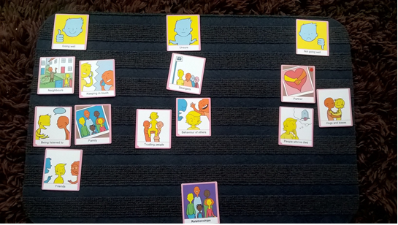
Relationships (going well)

Slide 43
Other free resources https://www.talkingmats.com/projects/free-stuff-communication-disability/
Visual CARE Measure
an adapted version of the CARE Measure which can be used to assess person’s views of practitioners’ communication and relational empathy abilities
Promoting Inclusion and Participation
an online learning resource for staff working with children and young people who use Alternative Augmentative Communication

Slide 44
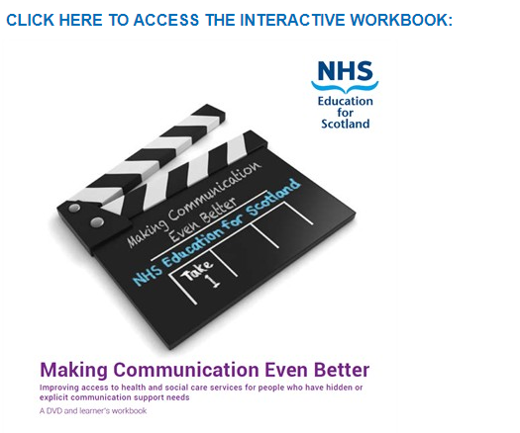
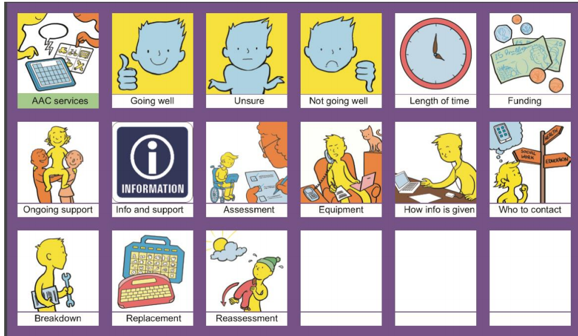
Making communication even Better -An online learning resource created by people with communication support needs to help health and care staff reflect on their improving communication – great AAC video clips
How good is your AAC service?
To enable AAC users to give
feedback on their services
https://www.talkingmats.com/projects/free-stuff-communication-disability/

Slide 45
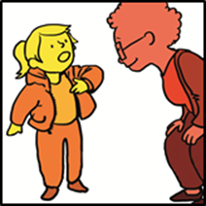
Future plans
Employability / Careers
Criminal justice network
A Children's Rights Approach

Slide 46
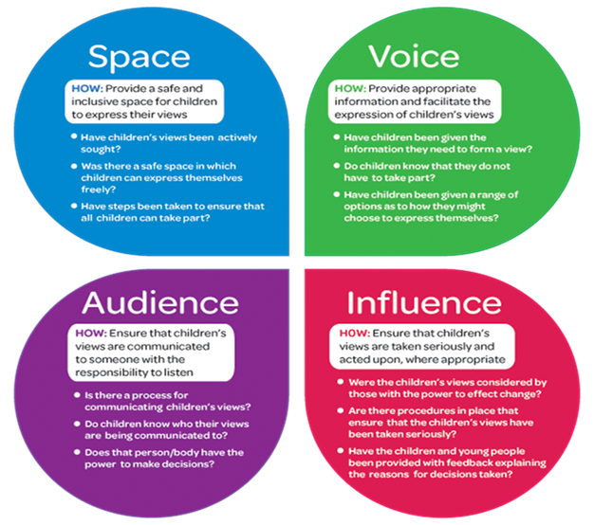
A Children’s Rights Approach
3 sites x 24 - nursery - primary - secondary
Train staff
Children and young people
Listened to
Views recorded
Influence decisions
Pre and post evaluations
Laura Lundy, Prof of International Children's Rights,
Queen's University Belfast

Slide 47
Finlay

Slide 48
References
Light, J. (1988) “Interaction involving individuals using augmentative and alternative communication systems: state of the art and future directions", AAC, 4, 2, 66-82
Locke, J. L. (1998) "Where did all the gossip go? Casual conversation in the Information Age", American Speech Language Hearing Association, 40, 3, 26-31.
Lundy (2007) http://edz.bib.uni-mannheim.de/daten/edz-k/gdj/15/lundy_model_child_participation.pdf

Slide 49
Further information
Contact: joan@talkingmats.com
Free stuff: http://www.talkingmats.com/research-consultancy/free-stuff-communication-disability/
Blogs: http://www.talkingmats.com/category/blog/
Research and consultancy: http://www.talkingmats.com/research-consultancy/

