Slide 1

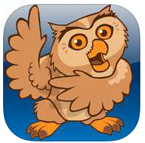
AAC Device Trial
Dagenham Park C of E School
Proloquo2Go
Jayne Kinghorn, Speech and Language Coordinator
3rd June 2014
Notes:
DP is a C of E Voluntary Controlled School / mixed gender with 1261 students currently on roll including ARP for 30 Students with MLD. In this case our student is guested into the ARP because of her multiple disabilities which include MLD/Hearing Loss/ Fasciosapulohumeral Muscular Dystrophy resulting in dysarthria causing significant articulation difficulty. On entry to DP following a meeting with GOSH and Julia’s primary school teachers and family it was decided that we would continue the trial that was begun in primary school. This was a first for our school raising questions of how to support Julia using the IPod and Proloquo2Go software, how to record usage and the long term considerations beyond secondary education.

Slide 2
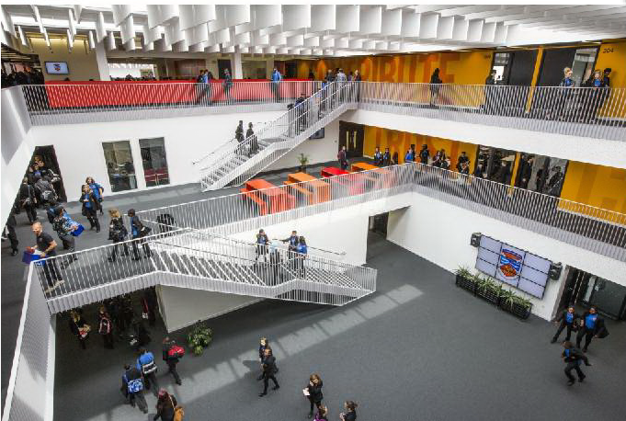
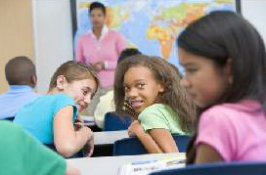
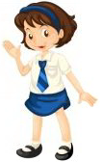
“Practise Makes Perfect…....” Trial 1 x4 weeks
Preparation
Teacher comments of student communication preferences
Functional targets for student aims and outcomes prepared by SLT/School
Separate training sessions provided for Special Support Assistants and teachers – x1 hour
Monday Morning School Briefing - Use of existing lines of communication
Tick box sheet for SSA’s to record student usage of IPod
Final Report with data
Peer reactions
Break time opportunities for data collection
Student voice
Notes:
We began with the following plan as listed on the screen but realised there were a few major missing pieces at the end of the first trial. The main and probably most important piece missing was student voice, knowing how Julia felt about the whole idea in secondary which is very different to a primary setting. I didn’t feel I had given Julia enough opportunity to express her own ideas or thoughts and opinions although in general Julia just went along with whatever was suggested.
An opportunity should have been provided for Julia without lots of adults surrounding her for her to express her real thoughts on the trial. We had not really considered the reaction of Julia’s peers either which is important because their reaction could easily influence Julia’s willingness to try the IPod out. Lastly we had not accounted for break time communication between Julia and her peers which could have provided much more data to analyse and use to inform decision making at the end of the trial. The training sessions for staff for the software were interesting; teachers preferred to have mini sessions 1-1 which was far more time consuming but they could then choose times that suited them better. The Special Support Assistant’s (SSA’s) were interested in how the system worked which although simple in reality for some including myself was difficult at the beginning. I used pictures cues throughout which they seemed to enjoy far more and could take away with them and refer to when needed.

Slide 3
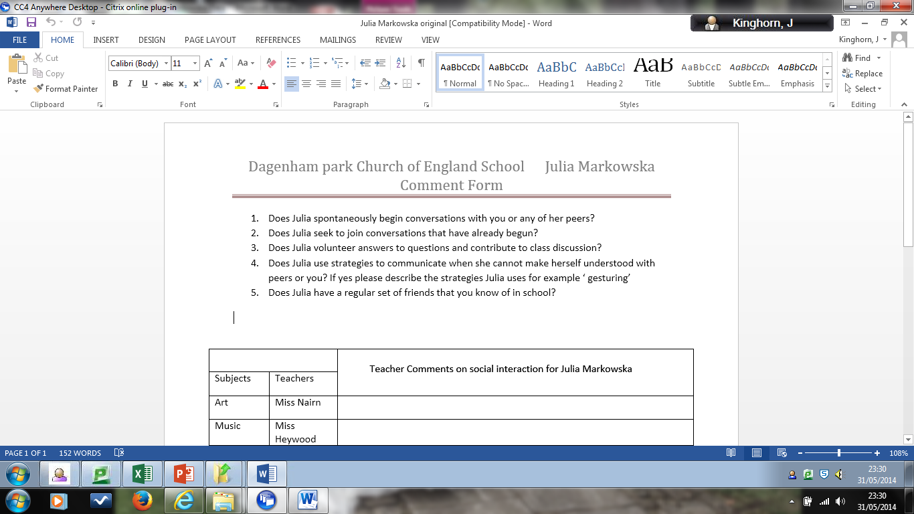
Teacher comments of student communication preferences
Notes:
We sent an email to all Julia’s teachers asking them to consider these questions to help the Speech Therapist and myself to set some functional targets for Julia while using the IPod and software.

Slide 4
Some Teacher Comments Received Trial 1
1
2
3
4
5
Art Teacher
Julia does not spontaneously begin conversations with me however she does on occasions communicate with others on her table.
Drama Teacher Julia rarely begins a conversation with me she often speaks to 2 girls. She will use
gestures to be understood but isn’t keen on using her white board for communication.
English SEN Teacher
Julia contributes and is eager to participate and will communicate. She also seems to express her frustrations with communication much more. (than in maths)
PE Teacher Julia will gesture at me about how she feels with thumbs.
DT Teacher Julia sits with Kaitlyn….. I find it very difficult to always understand her (Julia)
but Kaitlyn usually helps me out.
Notes:
The comments teachers made really helped inform the targets we gave to Julia

Slide 5
Week | Lessons
Date ………………… Target | 1 A B C D E |  |  |  |  | 2 A B C D E |  |  |  |  | 3 A B C D E |  |  |  |  | 4 A B C D E |  |  |  |  | 5 A B C D E
Mon
Tues
Wed
Thurs
Fri
Student Targets for Trial
Volunteer an answer/question or statement
Start a conversation using the device
Device used listener to meet listener’s need
Device used in discussion with peer
Device used in discussion with adult
Notes:
A simple tick tally style chart was made for the SSA’s to observe Julia’s use of the AAC device with reference to the targets A to E

Slide 6
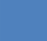
= Number of Times Device Used in Lessons over x4 Weeks
A B C D E
Notes:
This chart and the records for the first trial don’t really say all that much. We felt it should be more detailed showing the class Julia was in at the time so that we could see where Julia was using the device most often. We found 4 weeks was not really enough because of the high level of poor attendance by the student because of her disabilities. It was also decided after the first trial to tweak target ‘C’ – To meet listener’s needs and change it slightly to Device used when message could not be understood by listener. We felt this was a more specific target for Julia and data collection and analysis later.

Slide 7
Outcomes
More time for the trial
Creative sabotage
Role play activities to be used in second trial
Record times AAC is used when there is a break down in communication
In the event of Julia being supplied with a device who will be responsible for loading key words on with symbols and keeping the device charged?
Notes:
More time – Would mean more usage by Julia to explore using the IPod.
Creative sabotage – Julia uses friends as human alternative communication devices (translating Julia’s messages) GOSH Technologist Tom Griffiths suggested asking Julia’s friends to not always translate for her but encourage her to use her IPod. JK met with Julia and then her friends to discuss the idea of less human translating to ensure enough data could be collected and Julia could more easily evaluate it’s usefulness.
Role play – Julia has been studying conversation skills in her social skills group and using role play to practise repairing with her IPod. One of Julia’s ways to repair was to just use her IPod especially when adults didn’t say they don’t know what she was trying to say to them. Julia could pick up the social cues of body language and facial expression to tell her that the person really doesn’t know what she is talking about in the conversation.
Responsibility – This is a tricky one since during the first trial there were gaps where staff hadn’t loaded pictures on and times when SSA’s missed Julia’s use of the device or didn’t encourage her to make use of it mainly because of the general demands of support needed for all the students and we have been severely understaffed in our SEN department. This is being addressed now so the responsibility of the IPod can be met.

Slide 8
Trial 2
1
Notes:
All numbers from 6-41 should be numbered 1 to 5 for each week but this could not be shown on the chart.
Each of the numbers 1-5 represent each lesson 1 from Monday to Friday and continues through to each lesson 5 Monday to Friday. When cross referencing with Julia’s timetable and observation tick sheet we could see in which lesson Julia used her IPod and for what reason. This gave us much more specific information to help inform decision making.
Thurs week 1 period 1 in DT device was used to repair a breakdown in communication
Fri week 1 period 1 in PE the device was used in discussion with a friend
Julia used her IPod 137 times during 45 hours worth of break times 13 times in discussion with an adult and the majority in discussions with friends.

Slide 9
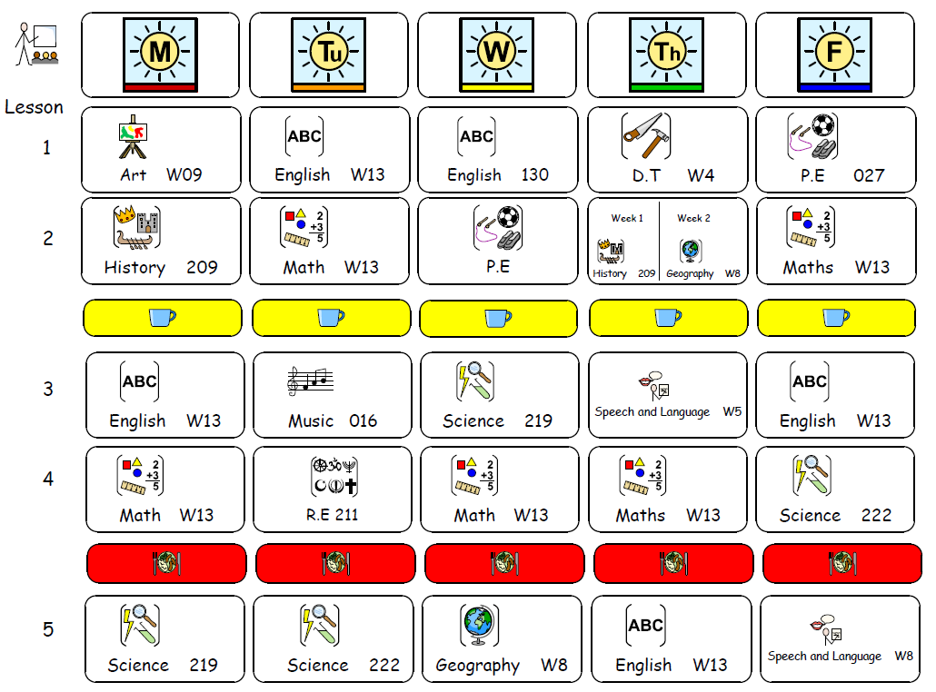
Notes:
Julia’s timetable together with the tick sheets helped inform and analyse the data.

Slide 10
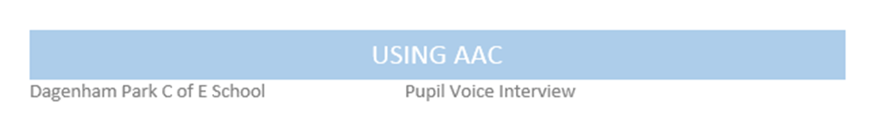
Notes:
During primary school Julia used text to speak but not very well because her literacy levels were so low she experienced difficulty being able to type what she wanted because of spelling and grammatical errors. In the first trial we encouraged her to mainly use the grid and the symbols however in the second trial Julia did use both and reported that she found text to speak very useful.

Slide 11
Notes:
Julia found she could keep up with her peers in conversation better because the device helped her speak quickly and say multisyllabic words. Many of the questions teachers ask in class require the use of multisyllabic curriculum words to be included in spoken answers and having the device could help Julia and with answering questions a teacher asked. Julia used the grid for directed questions.

Slide 12
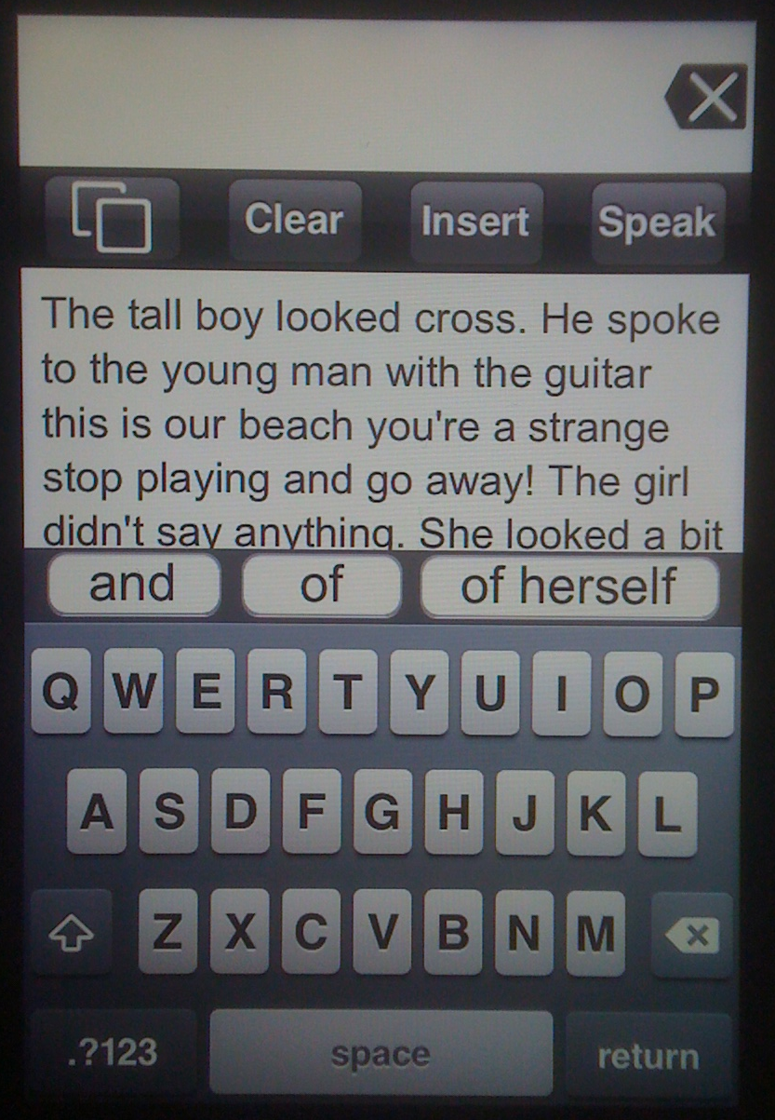
Appropriate Use
Making the most of the AAC Device
Notes:
Julia’s grammar and spelling has improved enough for her to be able to make use of the text to speak facility as she has indicated on the pupil voice interview. The example on the slide comes from an actual response to a directed request by the teacher to retell a narrative she had heard during the lesson. Without the IPod this long communication would have been far more laborious for Julia to say. This reply was accurate although the word ‘strange’ should have been ‘stranger’.

Slide 13
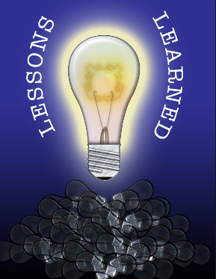
Lessons Learned
Record Keeping
Keeping Long Term Goals in focus
Keep it simple but thorough
Take time to set the trial up properly
Make sure key people are in the know
Have clear lines of roles and responsibility to ensure accurate data
Remember not everyone will share your enthusiasm to get involved – be creative
There’s a lot of donkey work involved
What were we aiming for?
Where do we go from here?
What about funding?
What about post 16 and transition to college?
Notes:
Time doesn’t allow for long complex approaches to record keeping in a trial in the mainstream secondary setting.
Having time to think it all through really helped and having time to analyse the 1st trial before starting the 2nd trial was very helpful
In the end speaking with teachers face to face and individually was most productive and providing a detailed training session for the SSA’s worked well so they could load keywords onto the IPod.
Everyone was clear about roles and responsibility however being understaffed at times due to illness and other duties meant gaps appeared in the record keeping leading us to reconsider and allow Julia to start keeping the tally which worked really well with adult monitoring.
Getting other members of staff on board isn’t always easy however I needed to remember that the IPod wasn’t the main form of communication for Julia but rather a back up and a very useful one at that.
The donkey work really involved chasing teachers for keywords most of the time and making sure the IPod was returned to the designated place each day and picked up in the morning.
We wanted to offer Julia an additional tool to enable her to communicate more easily in school with a view to what may be appropriate in years to come.
Our job now is to continue with using the IPod that GOSH have kindly allowed Julia to keep until the end of the year which we are grateful for and will further facilitate Julia’s experience of using such a device.
Funding is the big question we really don’t know at this point what way a device will be funded but will hopefully have some clarity by September when the new Education, Health and Care Plans come into play instead of the statements.
Our long term hope is that Julia will have come to know what works well for her with communicating and can take whatever she uses with her onto college and beyond.

